Slide 1

Sage 300 Technical Session After The Basics
John Thomas (JT)
Principal Software Architect
September 2022
Notes:
Welcome to the Sage 300 Technical Session which will cover information and topics after the basics presentation.
I am John Thomas, also known as JT, and I’m the Architect on the Sage 300 product.
Let’s get started.

Slide 2
Table of contents
Welcome
TPAC folks and quick review of The Basics
Information Sharing
Tips, How To’s, etc.
What’s New
Application and SDK
Declarative Report Framework
Explanation and Demo
Upcoming Items
Overview
Roundtable
What’s on you mind
Notes:
I am excited to bring you this session on After the Basics.
You are familiar with the basics of the Web API and the Web SDK. This session will quickly review The Basics session, present what’s new in the Sage 300 application from a technical perspective, what’s new in our 2023 release of the Web SDK, review and highlight some upcoming changes to the Web API and Web SDK, share some relevant information on tips, tricks, and how to’s in the code, present our new Declarative Report Framework for simple reports, and finally end the session with a roundtable discussion where we can have an open discussion on what’s on your mind regarding the API and the SDK.
And questions, suggestions and feedback are valuable for delivering an API and an SDK that meets as many needs, and requirements of the developer community as possible. So, please let your voice be heard!

Slide 3
Welcome
TPAC folks and quick review of The Basics

Slide 4
Welcome
TPAC and remote folks
You know the basics, let’s learn some more
Session
Recording will be made for download
Presentation
Web SDK’s docs/presentations folder
The Basics
Session and Presentation available
Vision
Web API
Contents and Purpose
Web SDK
Contents and Purpose
Accelerating development

Slide 5
What’s New
Application and SDK

Slide 6
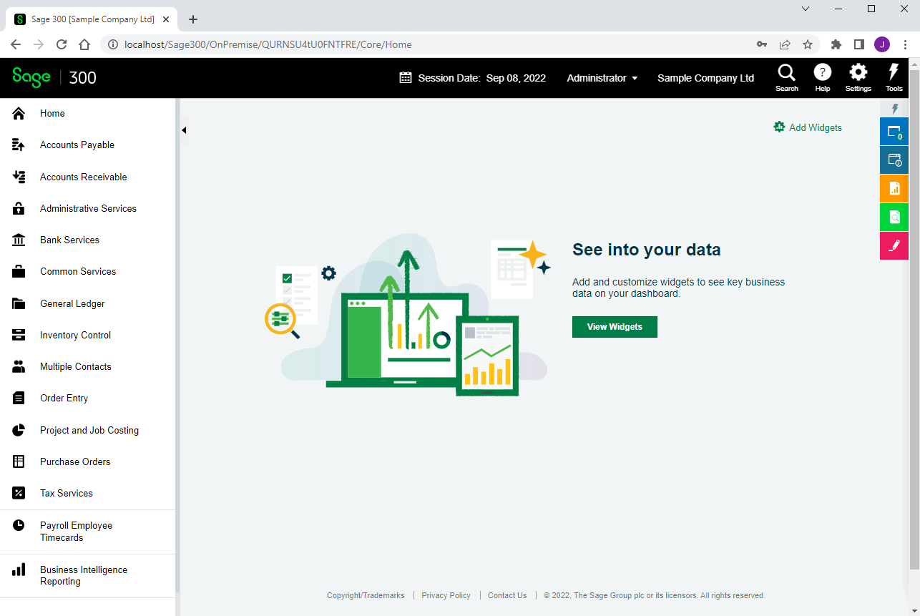
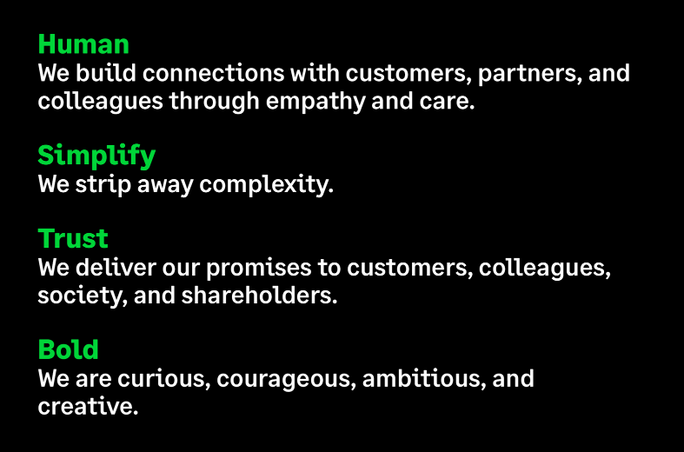
What’s New
Rebranding
Web Screens
New color schemes, styles, and icons
No code changes required
Upgrade Wizard upgrades all styles and icons
No developer work involved

Slide 7
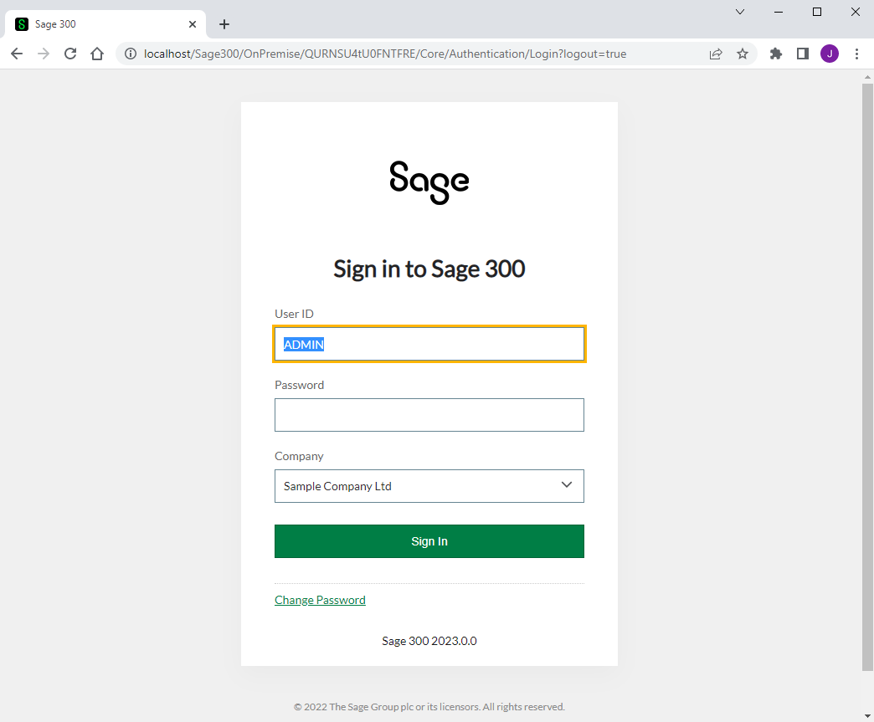
What’s New
Complex Passwords
Web Screens
Minimum 8 characters
1 upper and 1 lower alpha character
1 numeric and 1 special character
Special checkbox to enable this complexity has been removed in the Database Setup screen
Case matters
Code forcing case has been removed from all UI
For non-complex passwords, backend will know to force case to upper since UI case statements have been removed
Partner UI’s will require similar changes

Slide 8
What’s New
Azure Components
Web Screens
Removing these components from Web Screens
Target in 2013 was Azure
Target in 2015 changed to On-Premise
Kept around for compatibility and change of direction
Recent changes to Azure Components makes keeping compatibility without usage is unrealistic
No developer changes required
Simply a heads up

Slide 9

What’s New
FR for Web Delayed and SIRC Extended
Web Screens
Financial Reporting (FR) for Web delayed
Leveraged desktop implementation
Ability to use templates created in desktop
Got it working “almost” all of the time
Some scenarios caused failures
Leveraging Excel on server
Working with Microsoft on short-term and long-term implementation strategy
Sage Intelligence Reporting Cloud (SIRC) Extended
SIRC was to be deprecated in Sage 300 2023
Due to FR for Web delay, it has been extended
Simply a heads up

Slide 10
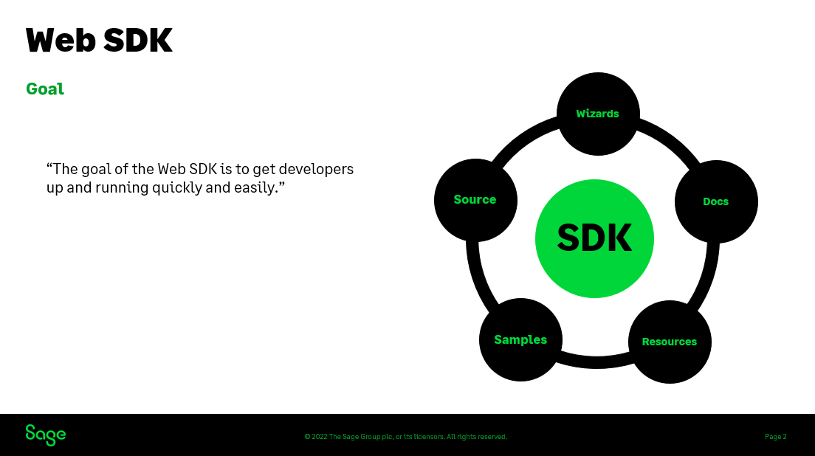
What’s New
Web SDK for Sage 300 2023
Web Screens
What’s new presentation in the Web SDK’s docs/presentations folder
Let’s take a quick look

Slide 11

Upcoming Items
Overview

Slide 12
Upcoming Items
Planned Web API and SDK work
Subject to change
Completed – 2023.1
Enhancement to delete customization files from file system
Currently when a customization is deleted, it is removed from the database but not the file system.
The desire is to remove the customization completely when deleted.

Slide 13
Upcoming Items
Planned Web API and SDK work
Subject to change
In-Progress – 2023.1
Web API Error Messages are not Specific
Error messages in the Web API do not raise the specific error message from the server which leads to frustration when attempting to diagnose failure.
The desire is to have specific error messages from server exposed while some messages will continue to remain generic (i.e., authentication, etc.).

Slide 14
Upcoming Items
Planned Web API and SDK work
Subject to change
Target – 2023.x
Suppression of Debug Messages
During the debug session of a solution, the debug output window is filled with numerous messages from the Sage Business Layers thus making it difficult to see developer debug messages to the console.
The desire is to allow developers to enable or disable debug messages from the business layers.

Slide 15
Upcoming Items
Planned Web API and SDK work
Subject to change
Target – 2023.x
Drilldown Framework Requires Global Implementation
The drilldown framework in the desktop has a global implementation which the web screens utilize. However, the drilldown framework in the web screens is module specific.
The desire is to have a global implementation in the web screens that can be implemented and invoked in any web screen where applicable.

Slide 16
Upcoming Items
Planned Web API and SDK work
Subject to change
Target – 2023.x
Customization API
The administration of web screen customizations are performed by the Customization Administration screen.
The desire is to provide a UI-less API for the import and maintenance of web screen customizations.

Slide 17
Upcoming Items
Planned Web API and SDK work
Subject to change
Target – 2023.x
Web Finder Compatibility with AS0020
The web screen finder is not compatible with business view AS0020.
The desire is to allow a finder definition to be successful with this business view.

Slide 18
Upcoming Items
Planned Web API and SDK work
Subject to change
Target – 2023.x
Numeric Composite Helper has hide/show issue.
The numeric composite helper hides the label and input widget successfully but un-hiding only displays the label. This is due to a layering issue in the supporting helpers.
The desire is to be able to successfully hide and un-hide widgets as expected.
Note: A workaround is to place the hide/un-hide check on the <DIV> element as opposed to using the composite helper property.

Slide 19
Upcoming Items
Planned Web API and SDK work
Subject to change
Target – 2023.x
Finder Composite Helper does not Implement a Hamburger Label
The finder composite helper has the interface properties to create a hamburger label; however, the composite helper does not have the supporting logic.
The desire is to implement this functionality for the exposed interface.

Slide 20
Upcoming Items
Planned Web API and SDK work
Subject to change
Target – 2023.x
Customization “Before ID” logic is Incorrect
When creating a customization and determining widget placement, if a widget is required, does not respond to this property.
The desire is to properly react to placement of a widget either before or after a target widget.

Slide 21
Upcoming Items
Planned Web API and SDK work
Subject to change
Target – 2023.x
Solution Generation Wizard to create {XX}CommonResx file
Internal Sage solutions have a common resource file per module, and this should also be done for partner solutions.
The desire is to provide this feature for partner solutions.

Slide 22
Upcoming Items
Planned Web API and SDK work
Subject to change
Target – 2023.x
Visual Studio 2022 for Development
The Sage 300 Web SDK Wizards are compatible with Visual Studio 2019. With the recent release of Visual Studio 2022, the desire is to have these wizards be compatible with 2022.
Note: This was attempted for the recent release of Sage 300 2023; however, with the new Visual Studio 2022 format, the 2019 wizards are not compatible with 2022 and this could not be overcome for 2023. Work with Microsoft is on-going.

Slide 23
Upcoming Items
Planned Web API and SDK work
Subject to change
Target – 2024.x
Web Screen Proxy
Currently Sage 300 web screens can be invoked and displayed within an iFrame in Sage CRM. However, this proxy has specific Sage CRM bits. With the upcoming development of Sage 300 Payroll web screens and the integration with Sage HRMS, this proxy will be modified to allow generic access.
The desire is to the display a Sage 300 web screen from any caller by leveraging the proxy.

Slide 24
Upcoming Items
Planned Web API and SDK work
Subject to change
Target – 2024.x
Moving Away from Knockout
Knockout is used for two-way binding in the web screens. We have performed a POC with using Kendo MVVM for two-way native binding.
The desire is to eliminate Knockout in-lieu of a more native implementation.

Slide 25

Information Sharing
Tips, How To’s, etc.

Slide 26
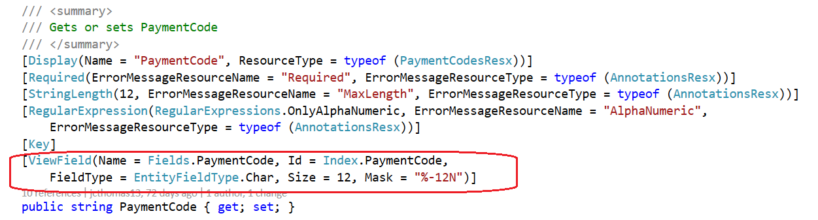
Information Sharing
ViewField Attribute
What is it?
An attribute assigned to every public property of an MVC model containing relevant information from the underlying business view
Why is it needed?
Not all business logic requires this attribute, but for those that do, it simplifies the managed code when the property is being assigned from JavaScript
Will be leveraged by future HTML Helpers to simplify CSHTML code
Do all model properties have this attribute?
Yes, as of Sage 300 2023 (whether they require it or not) via the new Sage 300 View Field Attribute Wizard. See Web SDK for more information.
Web Screens
ViewFieldHelper
GetPropertyId
GetPropertyName, GetPropertyFieldType
GetPropertySize, GetPropertyPrecision
GetPropertyMask, GetPropertyNumberDomain
return typeof(U).GetCustomAttributeValue<ViewFieldAttribute, string>(attr => attr.Mask, property);

Slide 27
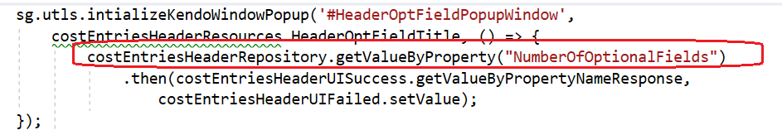
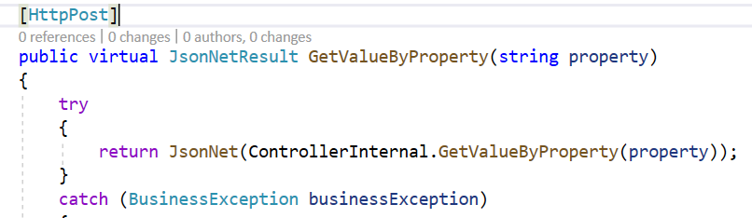
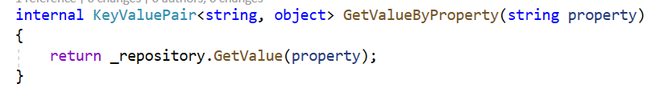
Information Sharing
ViewField Attribute Example 1
Web Screens
Gets access to business layer property without having to know Index or Name
Base Repositories have methods that already use helpers today
GetValuesByProperty
return GetValue<U>(ViewFieldHelper.GetPropertyId<U>(property));
SetValueByProperty

Slide 28
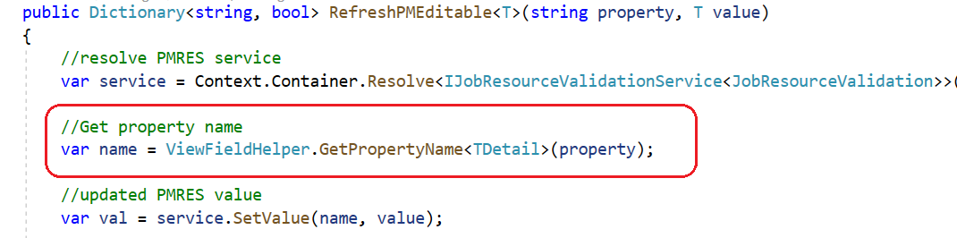
Information Sharing
ViewField Attribute Example 2
Web Screens

Slide 29
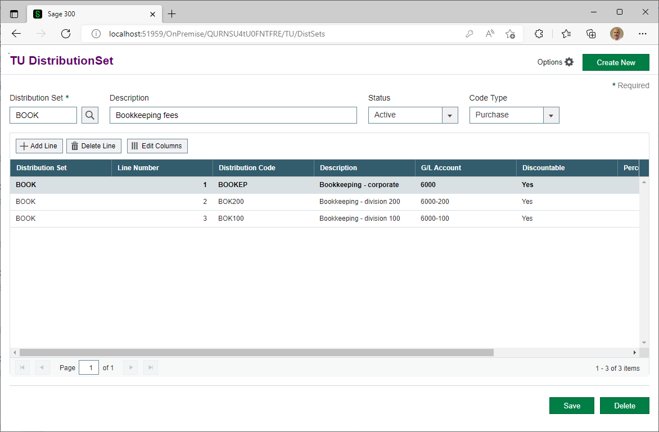
Information Sharing
Create and Sync a Header Grid to the Detail Grid
Can you create a header grid?
Yes!
Can the Code Generation Wizard create a header grid
Yes!
What needs to be added to sync the grids?
Let’s see!
Web Screens

Slide 30
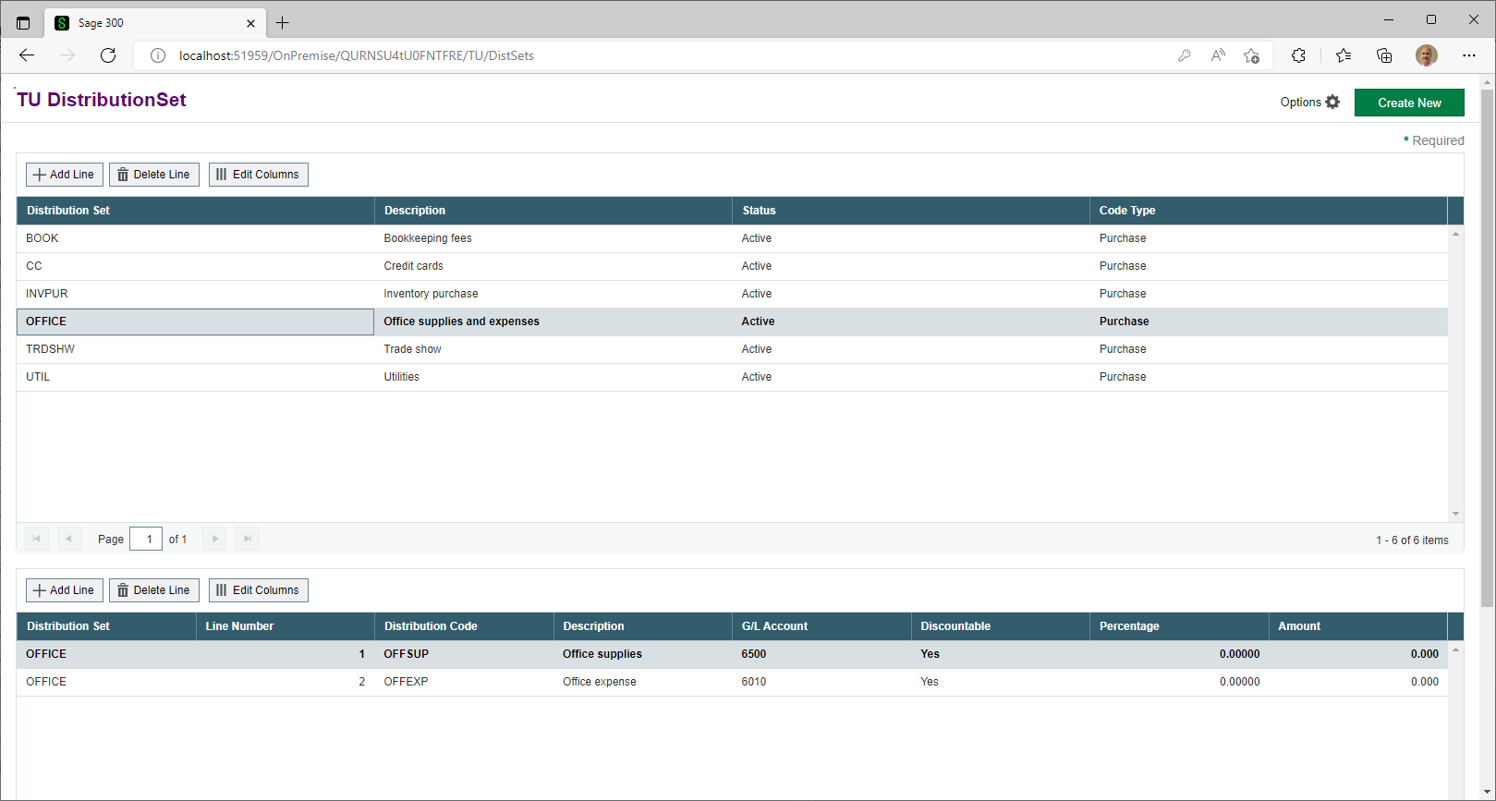
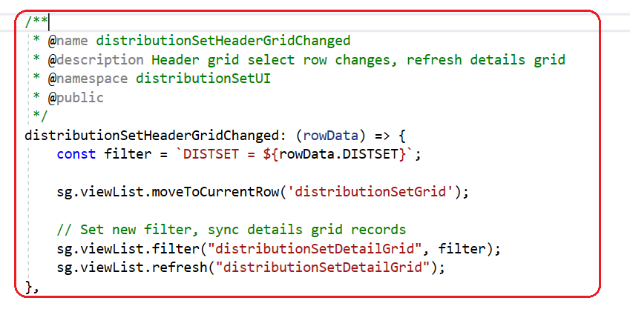
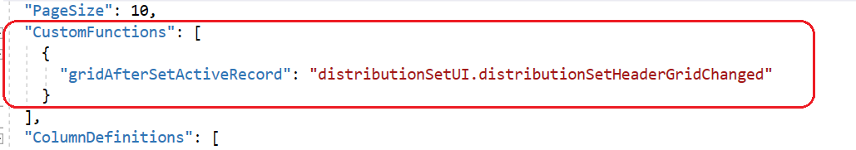
Information Sharing
Create and Sync a Header Grid to the Detail Grid
Behaviour JavaScript File
Note: Case of grid name is important!
Web Screens
Grid Header JSON File

Slide 31
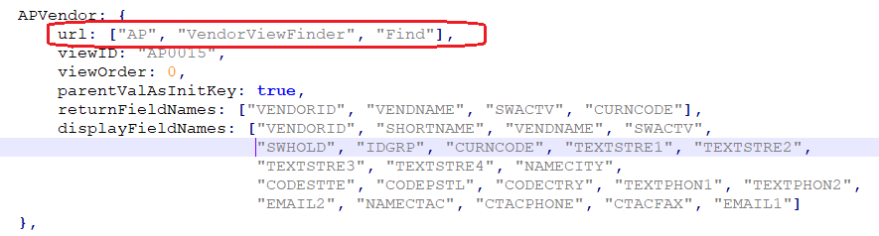
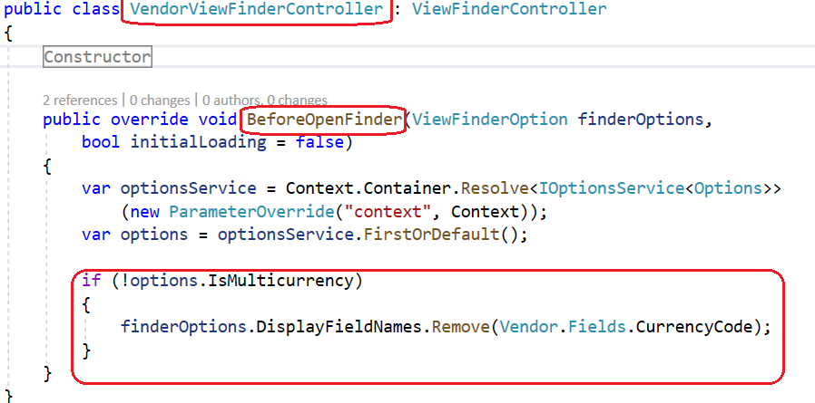
Information Sharing
Explain the Optional URL Property in a Finder Definition
The URL is an optional array that sets a path to override the default entry point of a finder
It is used when a finder requires logic before the initial load (i.e., showing or hiding a column depending on some logic)
Shown on the top left is our finder definition for a Vendor
Shown on the bottom left is the VendorViewFinder class/controller that is invoked prior to the finder controller (framework) being invoked
If multicurrency is not enabled, it removes the CurrenyCode field from the definition/display
Encapsulates logic in a single location instead of having multiple definitions or distributed logic
Web Screens

Slide 32
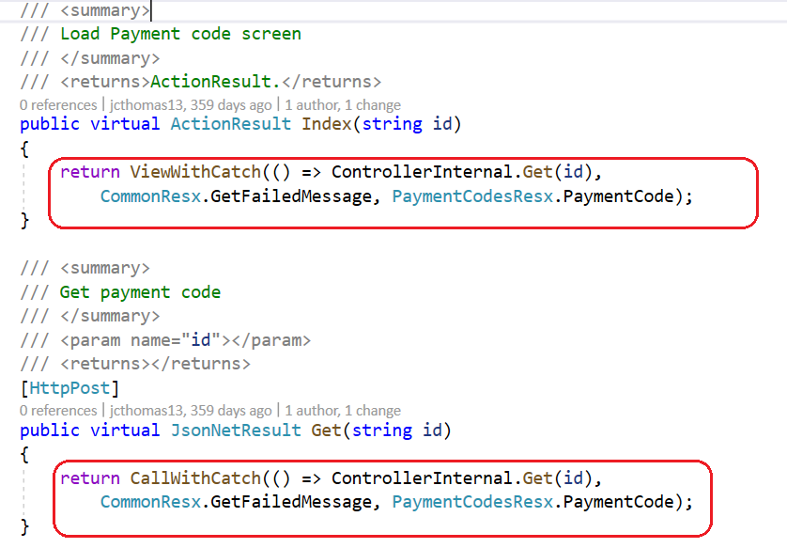
Information Sharing
Controller’s ViewWithCatch, CallWithCatch, Better Encapsulation
Public controller methods introduced a couple of releases ago that allow consistent and encapsulated error trapping of public methods
Code Generation Wizard generates this code
Still lots of boilerplate code that can be pushed down into a base class
Public and Internal controller’s for a simple screen contain over 300 lines of code
AR Payment Code
Public controller has 161 lines
Internal controller has 163 lines
That’s 324 lines for a simple screen
What if the 324 lines can be reduced to 106?
Let’s see how
Web Screens

Slide 33
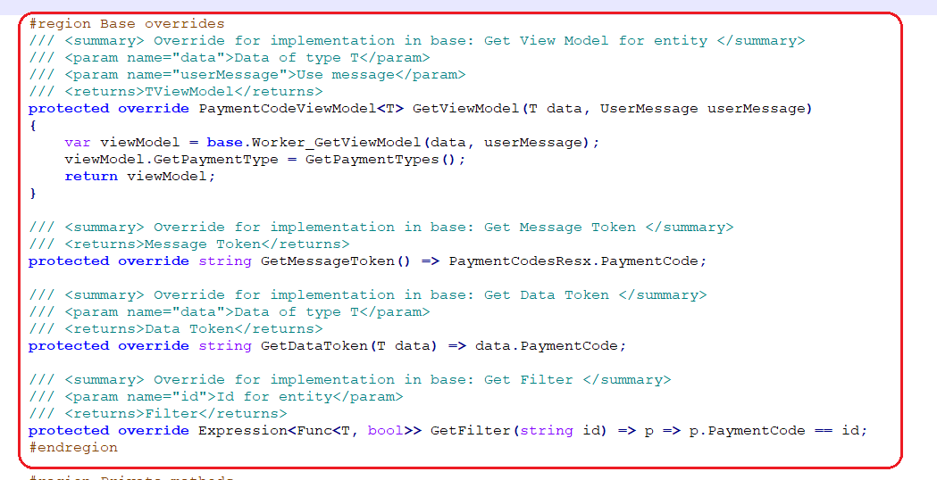
Information Sharing
Controller’s ViewWithCatch, CallWithCatch, Better Encapsulation and the Future
New controller inheritance
Eliminate internal controller
Public methods pushed down to base class
Overrides in derived class for common token replacements and usage
3 minimum overrides
Any base method may be overridden
Reduces code by 68%
Reduces developer error by eliminating redundancy
Still in POC but super excited
Web Screens

Slide 34

Declarative Report Framework
Explanation and Demo
Notes:
In discussing the API and SDK, we’ll look at what composes the API and the content of the SDK. We’ll cover the benefits in leveraging the API and the benefits in using the SDK. I hope to show how using these two resources can accelerate development.
One point that I want to stress before we begin is that we do not distinguish between an internal and an external developer. And, by an external developer, I am referring to development partners and ISVs. We want external developers to have the same experience and opportunities as internal or Sage developers. Of course, there will be some differences like direct access to the framework, but internal developers use the SDK and API too, and our QA folks reply on the API as well to validate data. Therefore, the API and SDK are valuable tools for all Sage 300 developers.

Slide 35

Roundtable
What’s on your mind
Notes:
In discussing the API and SDK, we’ll look at what composes the API and the content of the SDK. We’ll cover the benefits in leveraging the API and the benefits in using the SDK. I hope to show how using these two resources can accelerate development.
One point that I want to stress before we begin is that we do not distinguish between an internal and an external developer. And, by an external developer, I am referring to development partners and ISVs. We want external developers to have the same experience and opportunities as internal or Sage developers. Of course, there will be some differences like direct access to the framework, but internal developers use the SDK and API too, and our QA folks reply on the API as well to validate data. Therefore, the API and SDK are valuable tools for all Sage 300 developers.

Slide 36
Thank you!

